Slide 1


HP Videos
Libraries & Players
August 2011
©2011 HP Confidential

Slide 2

Agenda
Here we go…please fasten all safety belts
HP background
HP Videos gateway & libraries
Embeddable video players
  Single and multi-video
  hp.com standards
  Social networking sites
Work List and Schedule

Slide 3
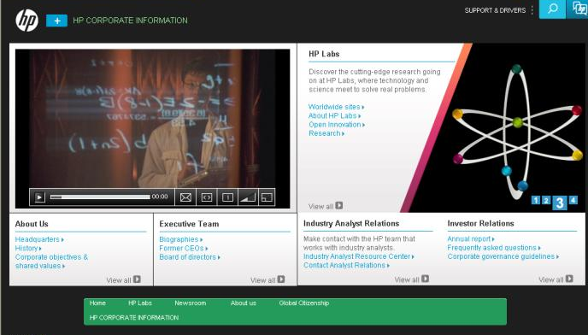
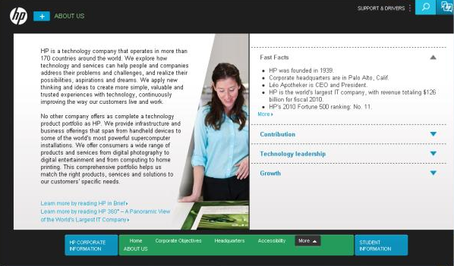
Company Information
http://www8.hp.com/us/en/hp-information/index.html

Slide 4
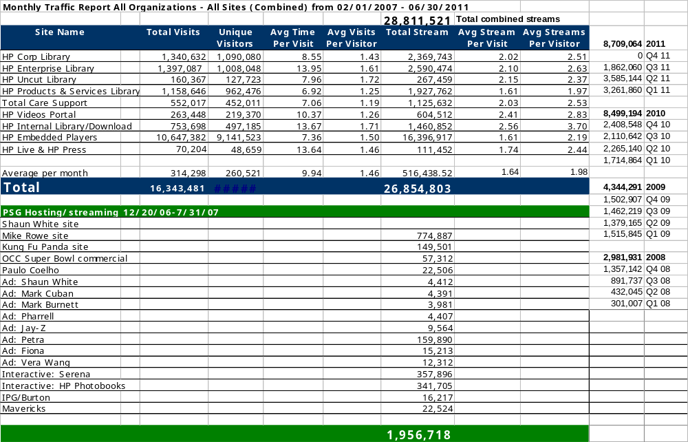
Metrics (thru 07/11 FY11)
Notes:
In the dark ages of 2005, the Enterprise video library (http://www.hp.com/go/etv) began with about 50 videos and averaged 4,000 visits and 8,000 streams per month
By comparison, the Enterprise library now has over 550 videos and in the last year, the collection and embedded players had over 400,000 visits and launched over 750,000 streams…plus visitors spend an average of 12.37 minutes in the library per visit and watch 2-3 videos, so these are very ‘sticky’ sites that keep visitors engaged.
When combined with the Corporate library (added a year ago) and Uncut library (added in September), HP Videos averages over 50,000 visits and over 100,000 streams per month.
HP Videos has also been hosting the flash streams for PSG’s The Computer Is Personal Again pages
With this foundation and added Region involvement, this can certainly grow.

Slide 5
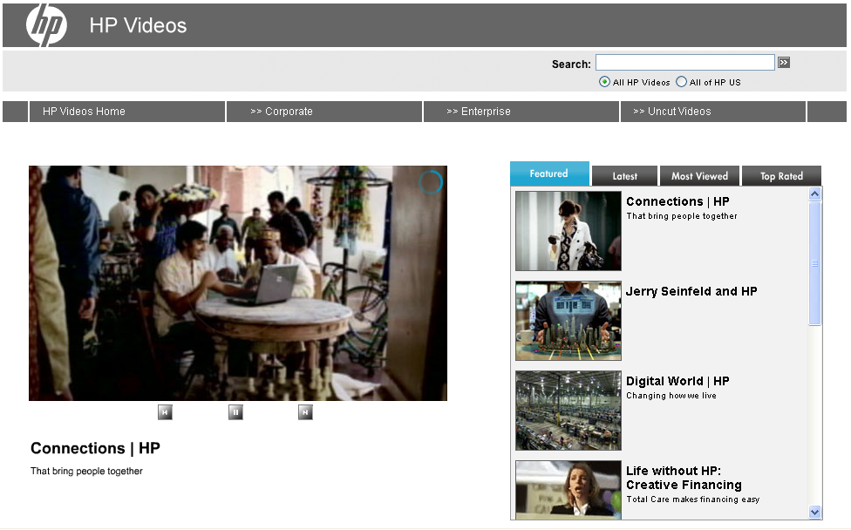
HP Videos Gateway
www.hp.com/videos
Corporate led and
cross BU endeavor
Progressive
download delivery
Editorially controlled
'Features' tab
Dynamically updated
'Latest,' 'Most Viewed‘
and ‘Top Rated’
Notes:
To improve the ‘face’ of HP Videos, the new portal was released at the end of January 2008, (http://www.hp.com/go/videos), which is a Corporate led, cross Business Unit and hp.com endeavor to improve the customer experience for videos across HP.
In addition to a new larger screen (set for 16:9 videos), it now delivers a progressive download stream (similar to YouTube) for better viewing.
To the right of the video window, there is an editorially controlled 'Features' tab that offers visitors a 'best of‘ view from the libraries. These rotate through each video until activated by the visitor.
The 'Latest,' 'Most Viewed‘ and ‘Top Rated’ tabs are dynamic, meaning they automatically draw refreshed information on a daily basis from the HP Videos asset management system.

Slide 6
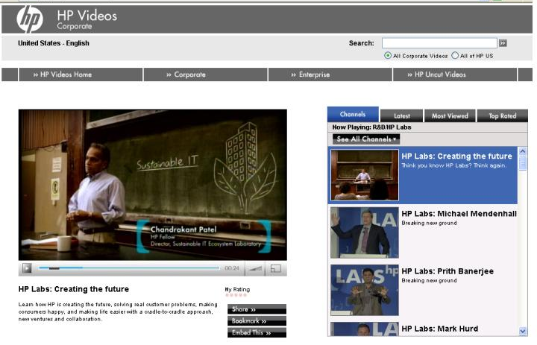
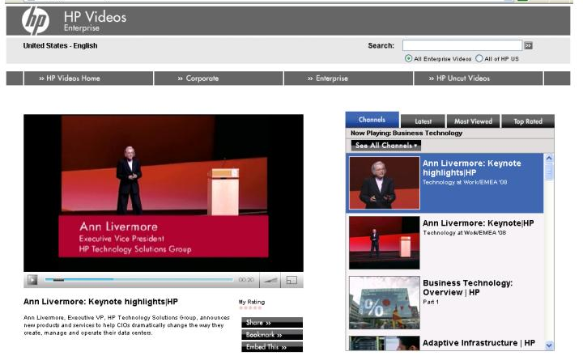
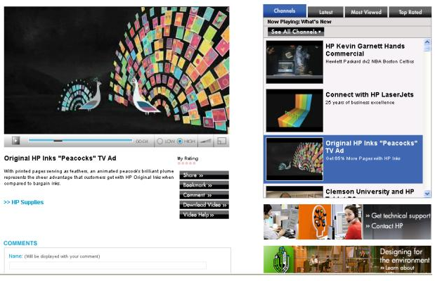
HP Video Libraries
Corporate
Enterprise,
Products & Services
Total Care Support
Notes:
By the way, this new look and feel will be added to all HP video libraries…Corporate, Enterprise, How To, Products & Services and Uncut.
A new ‘Commenting’ function will allow visitors to post their views as well.

Slide 7
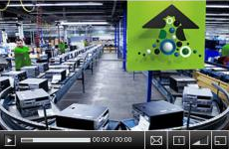
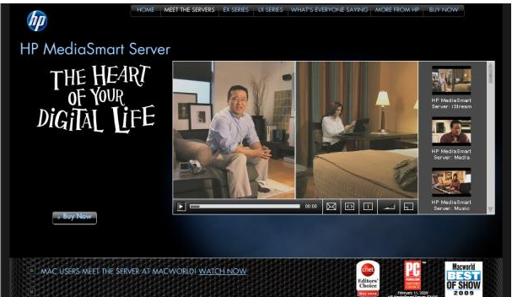
Single and multi-video players:
Now driving 60 percent of all streams
Notes:
Certainly we will want to continue to bring customers to the library experience to gain exposure to information they may not know exists.
However, it is also important to be mindful of customers’ time, and to supply what they want, when they want it.
To this end, HP Videos is unleashing a new set of single and multi-video players (there are more examples on the following pages), so that HP Videos library books can be embedded directly into hp.com and social networking pages.
Similar to the library, the videos are delivered via progressive download streaming to optimize performance for the visitor.
They have been tested in the primary hp.com publishing systems, and can be embedded into any hp.com page and even into flash environments (the PSG example above).
By design, they use HP Branding icons, making them language neutral.
They also have a rollover menu that allows viewers to share the video, get more information or visit the main library…and can be expanded to full screen size.
They will come in three basic sizes that adhere to hp.com column standards…
370, 275 and 180 pixels wide…AND can play either a single or multiple videos.
IPG localized for Swedish page http://www.hp.se/myterna/
TSG Ann Livermore http://h71028.www7.hp.com/enterprise/cache/583886-0-0-0-121.html
PSG Education embedded in a custom flash environment (Australia) http://www.hp.com.au/edu/solutions
Ian Griffin blog http://www.exec-comms.com/blog/business-communication/hp-labs-inspiring-video/
TSG StorageWorks multi-video player page http://h71028.www7.hp.com/enterprise/cache/583615-0-0-225-121.html

Slide 8
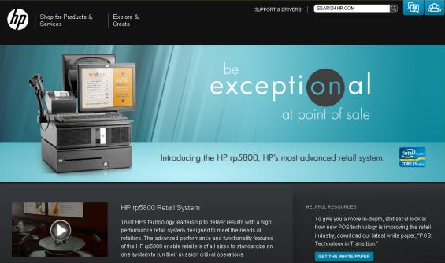
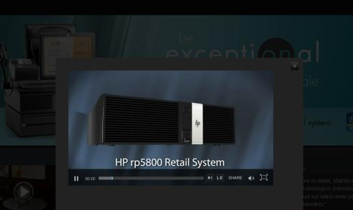
Dynamic Overlay technique
hp.com approved

Slide 9
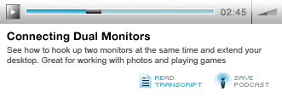
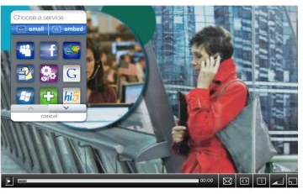
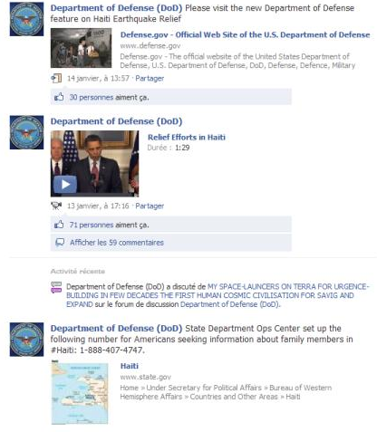
Embeddable Podcast and
Social Networking Players

Slide 10
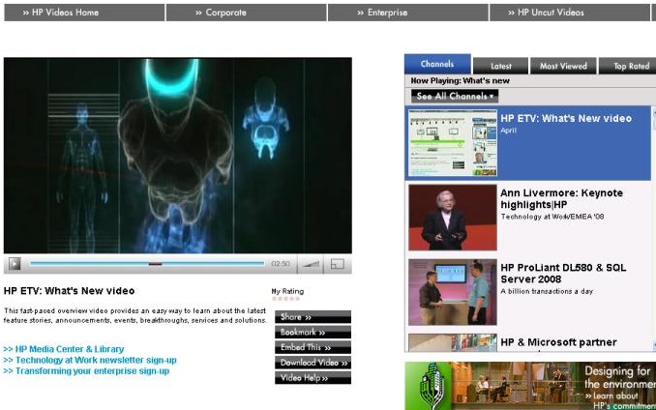
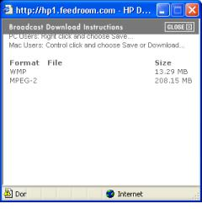
HP Video Libraries:
Automatic HP Internal redirect
HP Employees have
special sites for
downloading videos
Access to ‘HP only’ materials
HP Corporate library
  http://hpcorp1.feedroom.com
HP Enterprise library
  http://hp1.feedroom.com
HP Products & Services
  http://hpproserv1.feedroom.com
HP Total Care Support
  http://hphowto1.feedroom.com
Notes:
In addition to these customer-facing sites, there are special internal versions only for HP employees, so that high and low-resolutions copies of the library videos can be downloaded (via the ‘Download Video’ button) and shared with customers and partners in a controlled fashion.
As of April 2008, the software now detects employees on HP proxy servers and automatically re-directs them to the internal libraries.

Slide 11
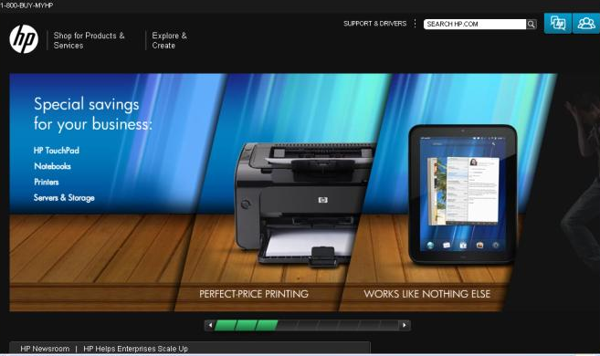
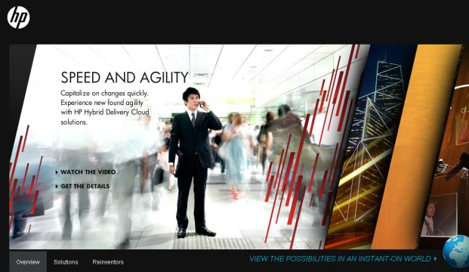
HP Cleansheet Design

Slide 12
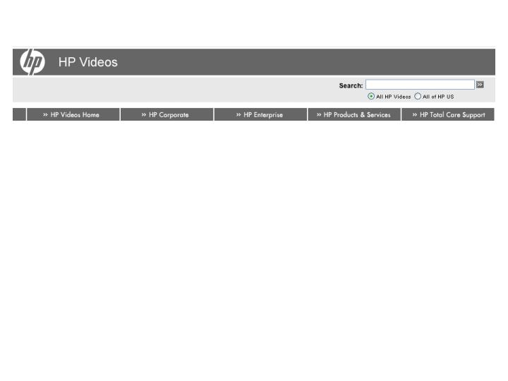
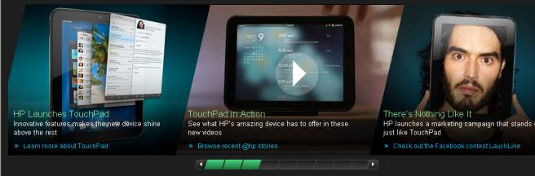
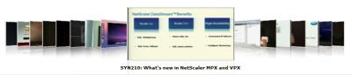
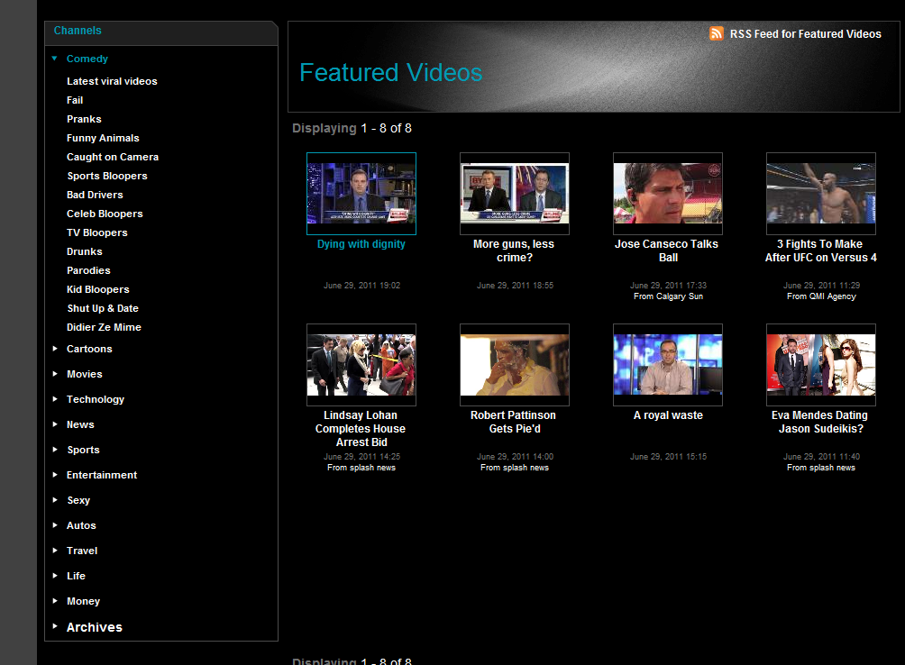

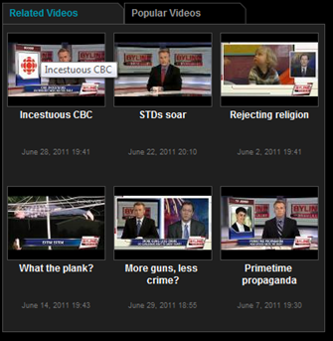
Name of library visible
Country/Language pull down. Would then go to different language gallery with local language and applicable videos displayed.
Ability to Search for video
Library options shown
Library Labels to use: Main, Computers, Printing, Enterprise Business, Support, Corporate
See the Citrix example for clean sheet like carousel www.citrixtv.com
[TABS] Fast access to most recent, most viewed, top rated
[FAR LEFT] Channel/Sub-Channel navigation so users can drill down through a hierarchy of topics
Different languages will show up as sub-channels here. (in the near future, have localized galleries that show only local language videos and channels).
Rules for what videos show up based on language/country selection TBD.
Notes:
Gallery Features shown above

Slide 13
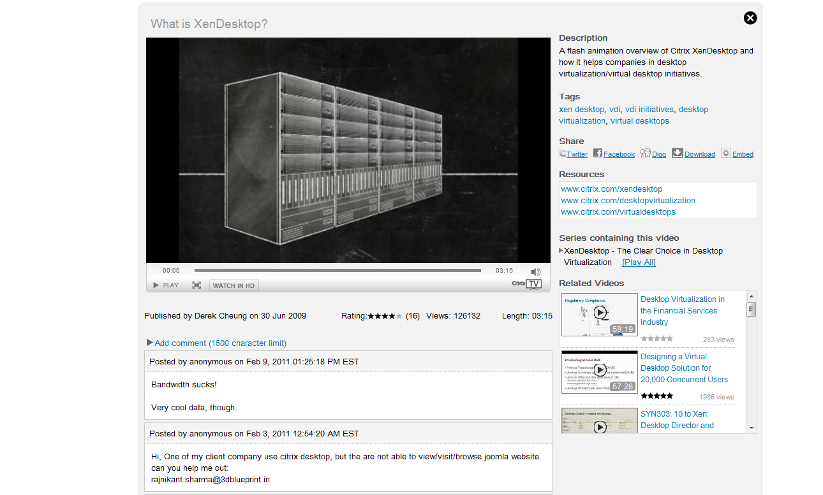
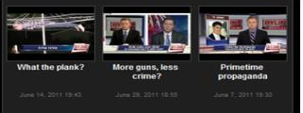
Gallery Player: Launched via Dynamic Overlay
Title - metadata
Capabilities:
Play/Pause
scrubber bar
running time
total time of video
total views
rating mechanism (thumbs up/down)
bit rate adjustment (HD)
captioning would activate if available (ability to select language desired for transcript)
volume
Full screen (?)
Metadata fields exposed
Player
overlays
on top of Gallery
Share buttons
Reference Links
Related Videos (e.g. recommendation engine. Positioning TBD
HD Option should show up only if a HD version of the video is available.
Nice to have: Ability to turn comments on or off per video. Ie. if a BU has a process around moderating and handling comments, they can turn them on. If not, BU can not have comments.
Another thought on comments is ability to send person who wants to make a comment to a thread on the video discussion in Lithium (HP forums).

Slide 14
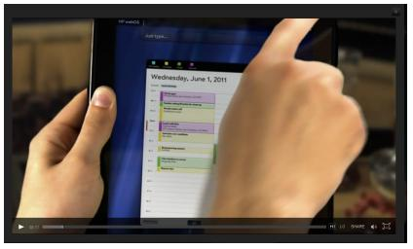
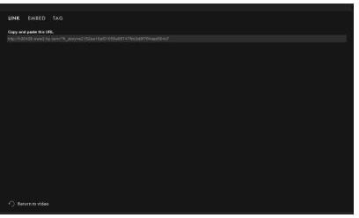
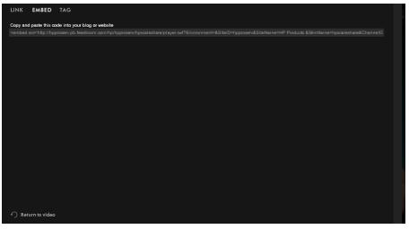
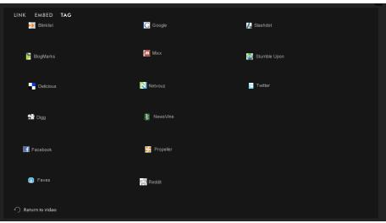
Single Player
Mouse-over controls
(Chromeless)
Capabilities
Play/Pause
Scrubber bar
Running time
Total time of video
Bit rate adjustment
Full screen option (?)
Captioning would activate if available
Volume
Sharing
Ratings
English only for now (but localizable)

Slide 15
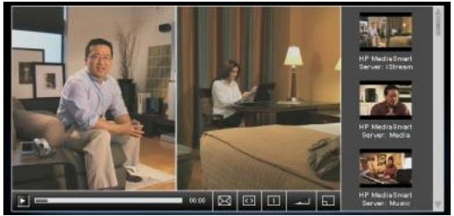
Multi-Video Player
Visible Controls
Capabilities
Play/Pause
Scrubber bar
Running time
Total time of video
Bit rate adjustment
Full screen option (?)
Captioning would activate if available
Volume
Sharing
Ratings
English only for now (but localizable)
Video list pre-determined from OVP. (Playing a playlist, admin controlled). Assumption this is playlist based.

Slide 16
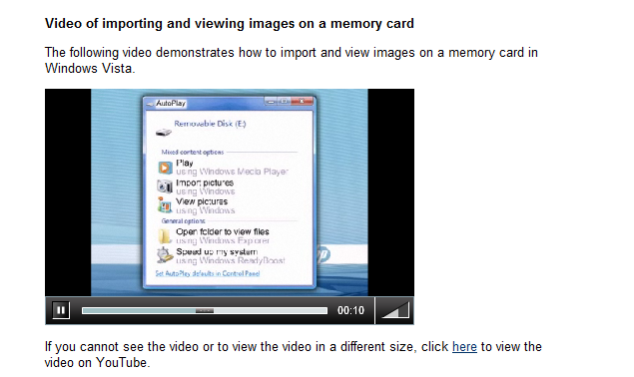
Language-free Player
Play/Pause
Scrubber bar
Elapsed time
Volume control
Need to add ratings capability
Full screen capability
May have text at next “level”. Can use hp.com sharing widget for translations (optional)

Slide 17
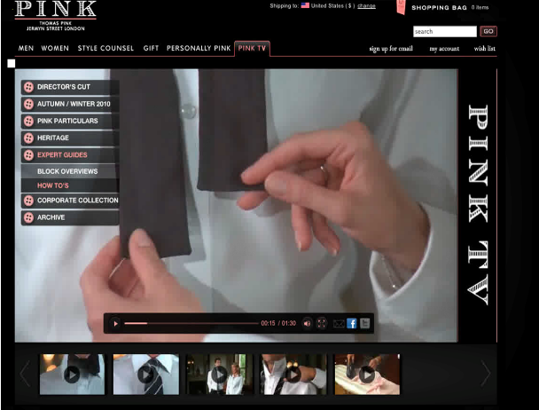
Branded Player

Slide 18
Deliverables for the User Experience Team
Galleries (2)
  1 mobile (English, but with hooks for localized versions)
  1 desktop (English, but with hooks for localized versions)
Players Gallery Player (English)
  Desktop
  Mobile
Desktop Players (10) (English)
  Single Video Players
    Chromeless (branded)
    Chromeless (non-branded)
    Visible Controls (branded)
    Visible Controls (non-branded)
    Language Free Player (icons only, no text, not even on mouseover
    Applicable for any region (language)
  Multiple video players (English)
    Chromeless (branded)
    Chromeless (non-branded)
    Visible Controls (branded)
    Visible Controls (non-branded)
    Language Free Player (icons only, no text, not even on mouseover
    applicable for any region (langauge)
Mobile Players (qty ?) Don't know the varieties needed, need input from UX team
  Smart player to detect platform (wireframes may be needed due to custom player need)
  Single video player optimized for touch

Slide 19
Working Schedule
Prioritize work
Budget analysis
Migration
Production
______________
______________
______________
______________
______________

